Slide 1
WEB PHISHING DETECTION USING MACHINE LEARNING TECHNIQUES AND FLASK WEB
PRESENTED BY
AASHIK EDWIN P (23PCN01)
II-MCA
THANTHAI PERIYAR GOVERNMENT ARTS AND SCIENCE COLLEGE(A)
THIRUCHIRAPPALLI
GUIDED BY
Dr. K. FATHIMA BIBI, M.Sc., M.Phil., Ph.D., SET
ASSISTANT PROFFESOR & HEAD
DEPARTMENT OF COMPUTER APPLICATIONS

Slide 2

INTRODUCTION
The internet has become an essential part of our daily lives, but with it comes the risk of cyber-attacks like phishing. Phishing is a deceptive attempt to steal sensitive information by pretending to be a trustworthy entity. These attacks use social engineering to trick users into clicking malicious links, often leading to fake websites that capture login credentials or financial data.

Slide 3
COMPANY PROFILE
Name of the Company:
S.A. CAREER DEVLOPMENT CENTRE.
S.A. Career Development Centre is a registered training center, officially approved on February 4, 2015, under the Indian Partnership Act, 1932. It is recognized by the Registrar of Firms, Tiruchirappalli.
The center helps students and working professionals improve their skills and career growth. It offers training, guidance, and support to help people get better job opportunities.
Their goal is to teach useful skills so that learners can succeed in their careers. With the help of experienced trainers and practical learning, they guide individuals to reach their career goals.
Contact Address:
Prof. Dr. S. Peerbasha,
9600466890,
trysacdc@gmail.com
T.V.S Tollgate, Trichy-20.

Slide 4

STATEMENT OF PROBLEM
Phishing attacks have evolved and become more sophisticated. For an average user, it's hard to differentiate between a real and a fake website. Traditional methods like blacklists are often outdated and not effective against newly created phishing websites. Therefore, there's a need for a smart system that can detect phishing links using advanced methods like Machine Learning.

Slide 5

AIM
To develop a web application that uses machine learning models to detect phishing websites. The application should allow users to input a URL and receive a prediction on whether it's phishing or legitimate.
OBJECTIVES
Collect and preprocess a dataset of URLs.
Train and evaluate different Machine Learning models.
Develop a web interface using Flask.
Integrate the best-performing model into the web app.

Slide 6
SCOPE OF STUDY
This project focuses on the automatic detection of phishing URLs using machine learning. The system is trained using data from public sources, including features of URLs. The final model is integrated into a Flask web application, compatible with all browsers.

Slide 7


Slide 8
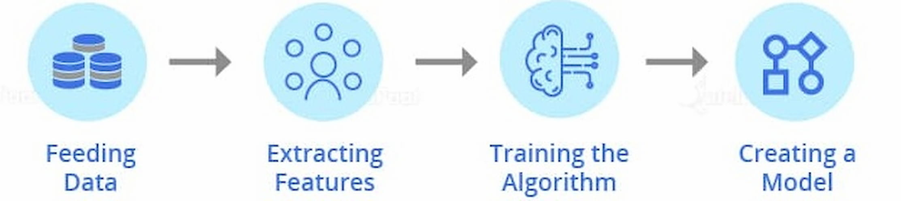




METHODOLOGY
An extensive review was done on existing works of literature and machine learning models on detecting phishing websites to best decide the classification models to solve the problem of detecting phishing websites.
Data Collection

Slide 9
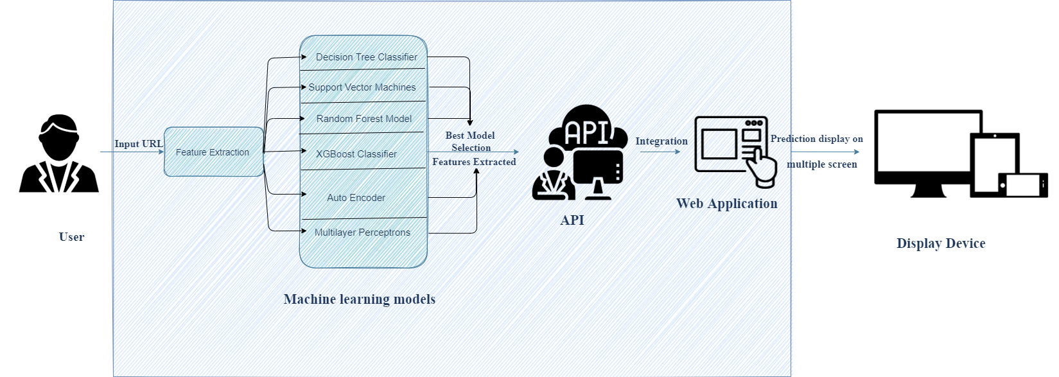
ARCHITECTURAL DESIGN
Catboost Classifier

Slide 10
ANALYSIS OF EXISTING SYSTEM
Low Accuracy: Current phishing detection systems often fail to correctly identify phishing websites.
High False Alarms: They sometimes give wrong warnings, marking safe websites as dangerous.
Blacklist Method Used: Most systems use a blacklist of known phishing sites to detect threats.
Not Updated in Real-Time: Since new phishing sites are created quickly, the blacklist cannot stay fully updated, making it less effective.

Slide 11
ANALYSIS OF PROPOSED SYSTEM
Machine Learning Used: The system uses various machine learning models and deep learning techniques for phishing detection.
Models Included: Models like Decision Tree, SVM, Gradient Boost, CatBoost, Multilayer Perceptron, and Random Forest are used.
Feature-Based Training: These models are trained and tested using features from both phishing and legitimate websites.
Best Model Deployed: The most accurate model is selected and connected to the web app to let users check if a URL is phishing or safe.

Slide 12
DATA COLLECTION
Phishing URLs Dataset (PhishTank)
Source: PhishTank Official Website
PhishTank is a community-based platform where users can report and verify phishing websites.
Size Used in Project: Approximately 5,000 phishing URLs.
Combined Dataset (phishing.csv)
After collecting both phishing and legitimate URLs, feature extraction techniques were applied to each URL to convert them into a structured format suitable for machine learning.
Total Dataset Size: After feature extraction, the combined dataset grew to more than 10,000 URL records.
The file contains 30 extracted features for each URL.
Legitimate URLs Dataset (University of New Brunswick, UNB)
Source: University of New Brunswick, URL Dataset (CIC-IDS-2016)
Description:
The UNB dataset contains legitimate URLs collected from trusted sources and popular websites.

Slide 13
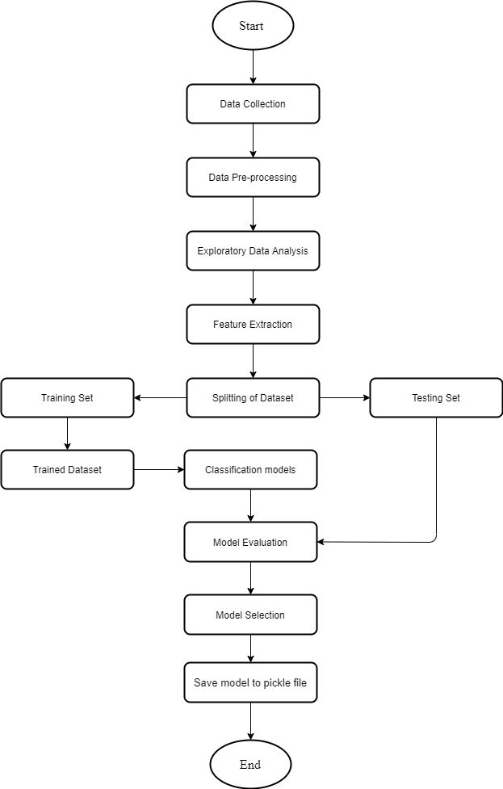
Machine Learning process

Slide 14
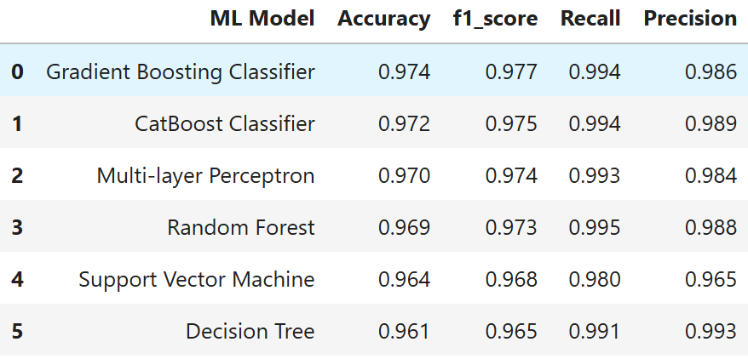
EVALUATED MODELS

Slide 15
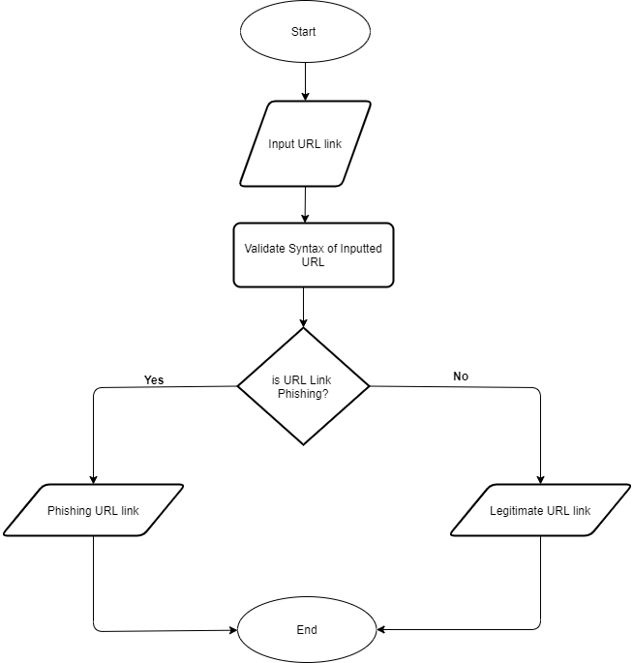
Flowchart of Web Application

Slide 16
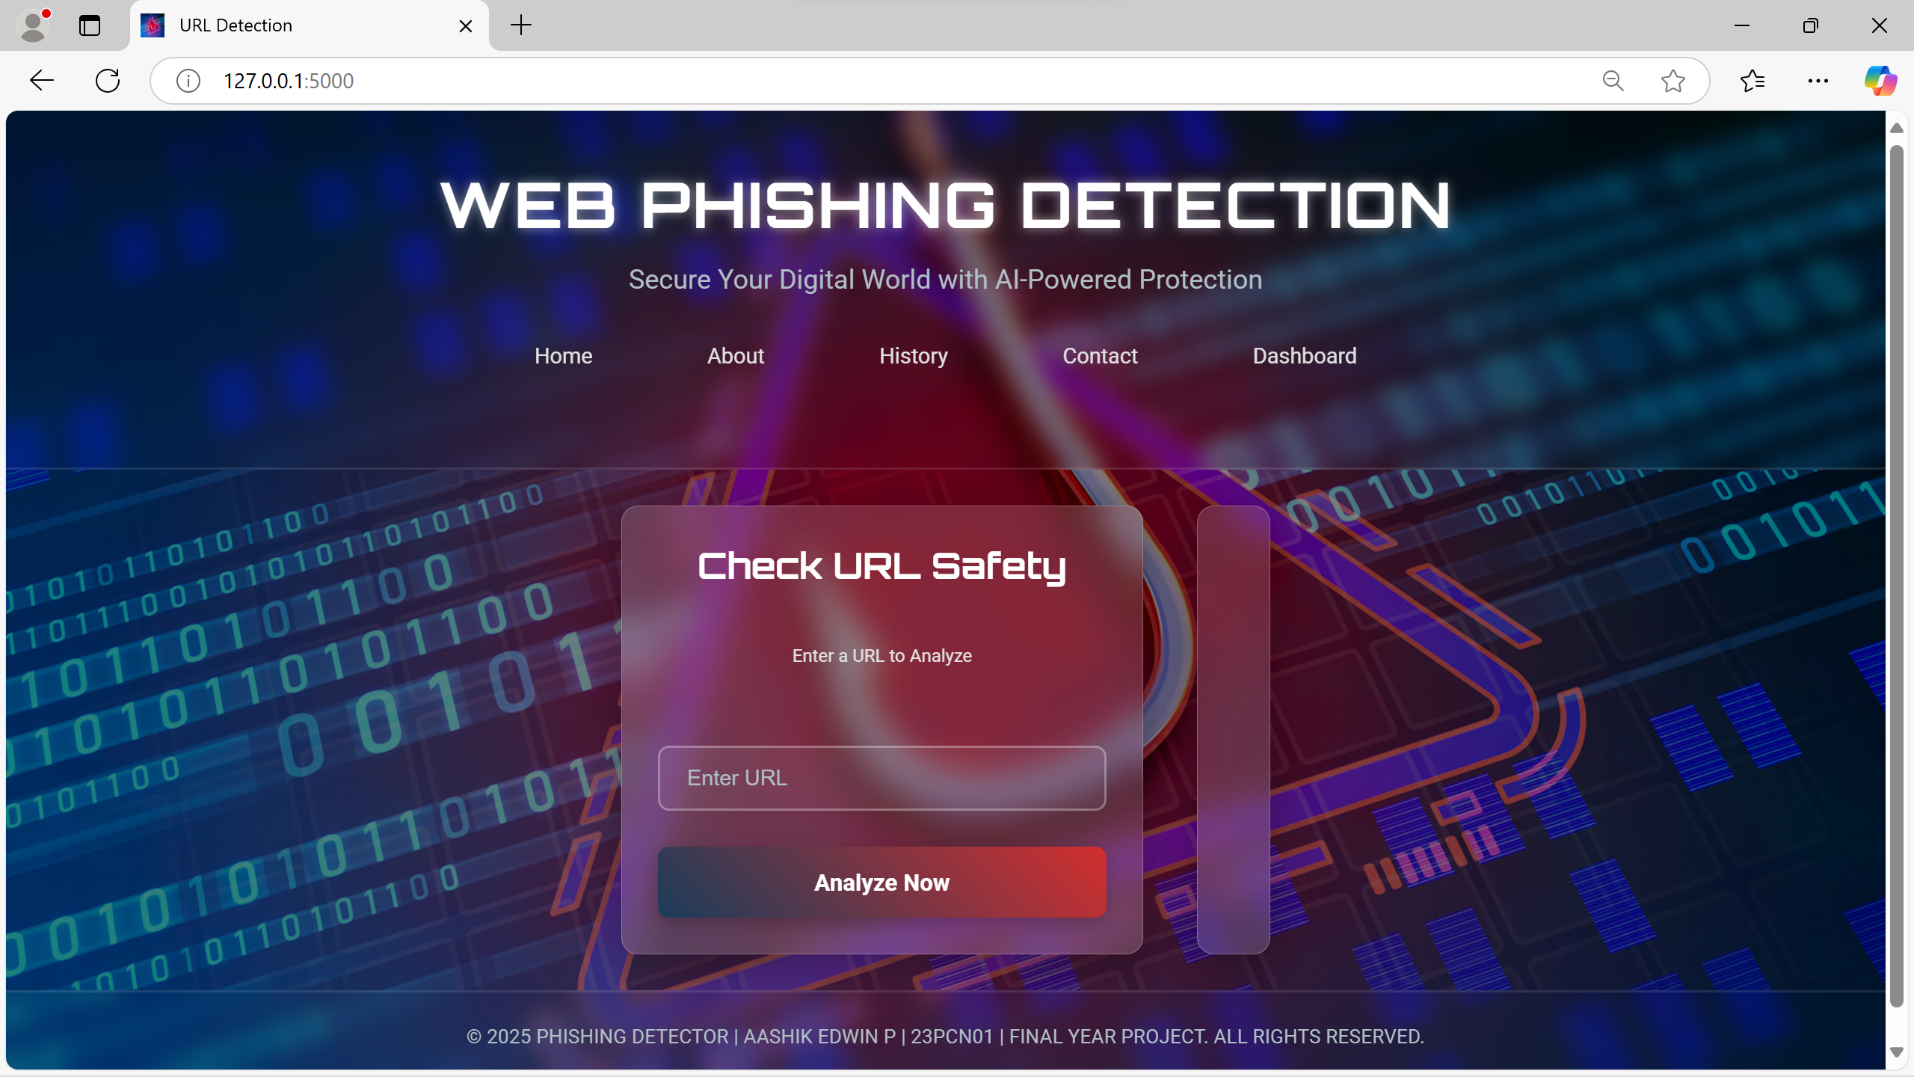
SCREEN INTERFACES
Home Page

Slide 17
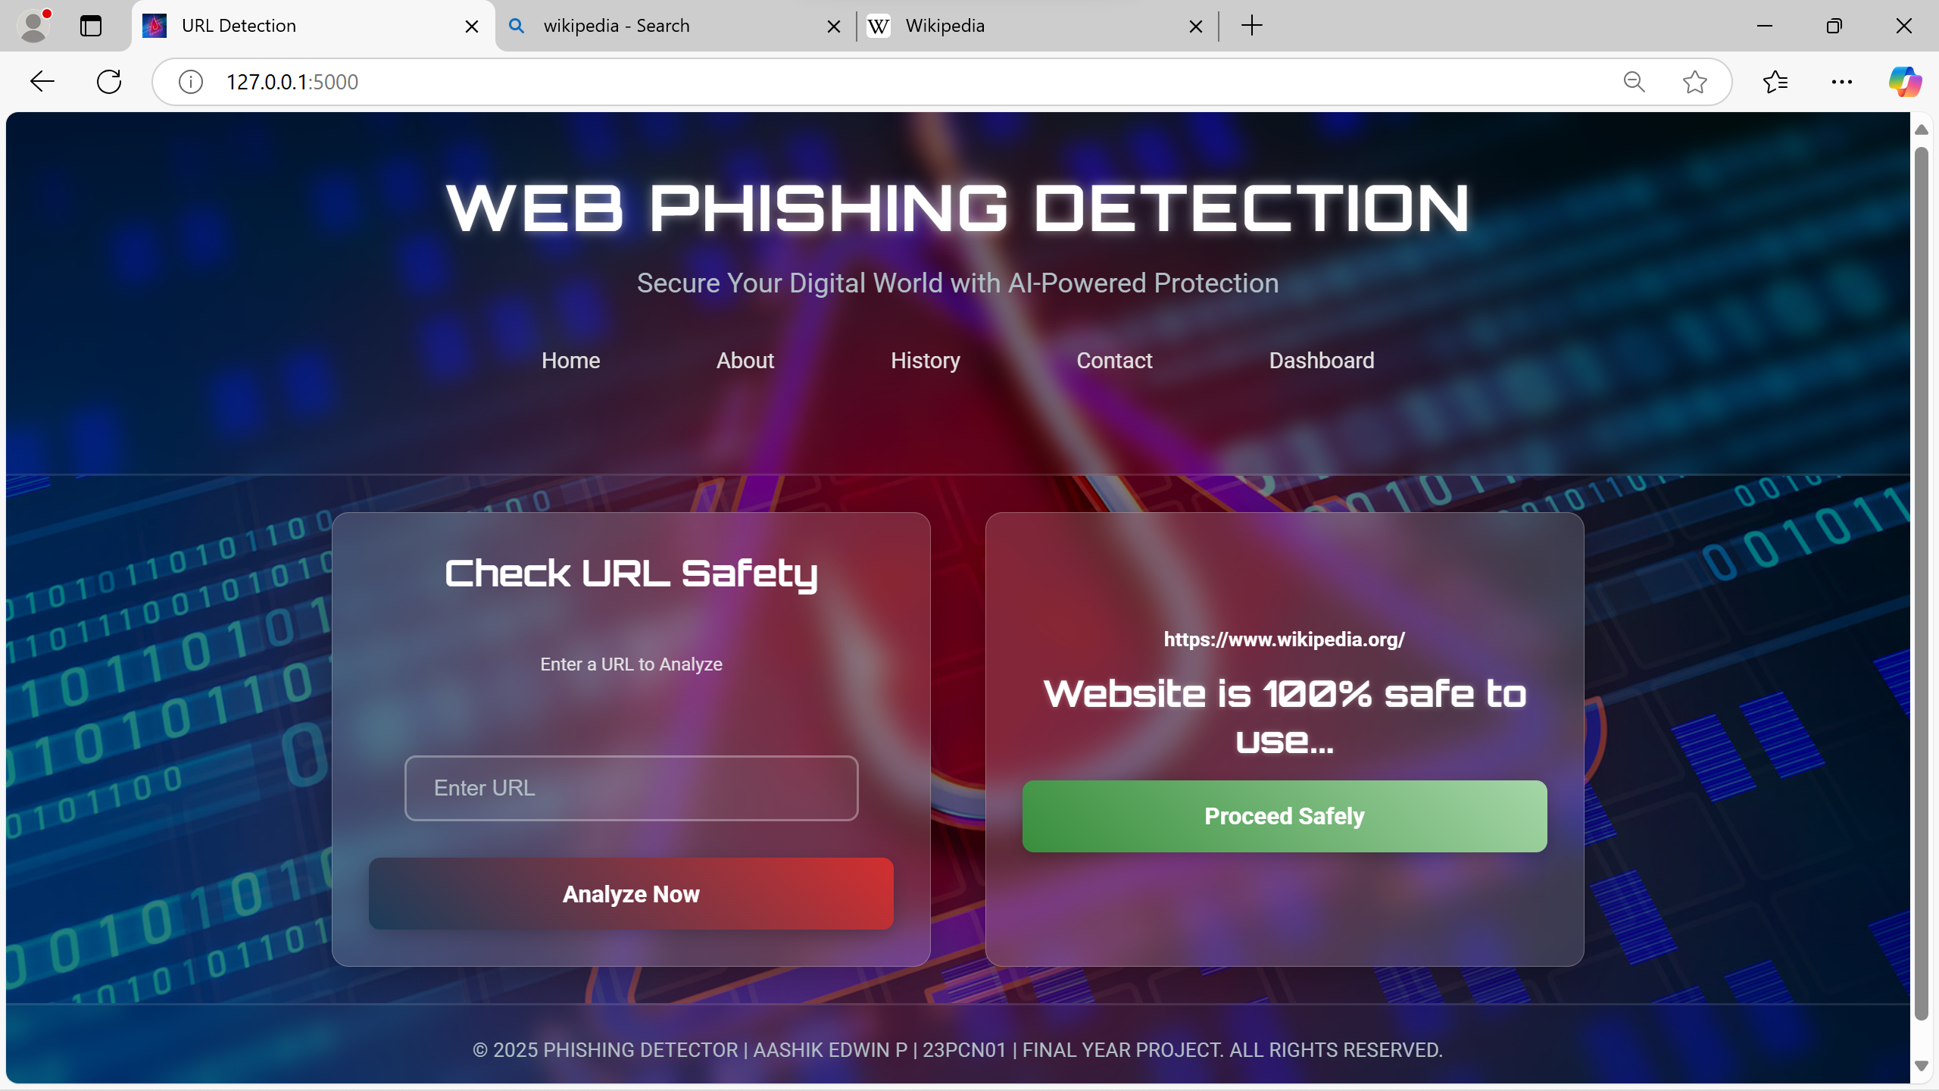
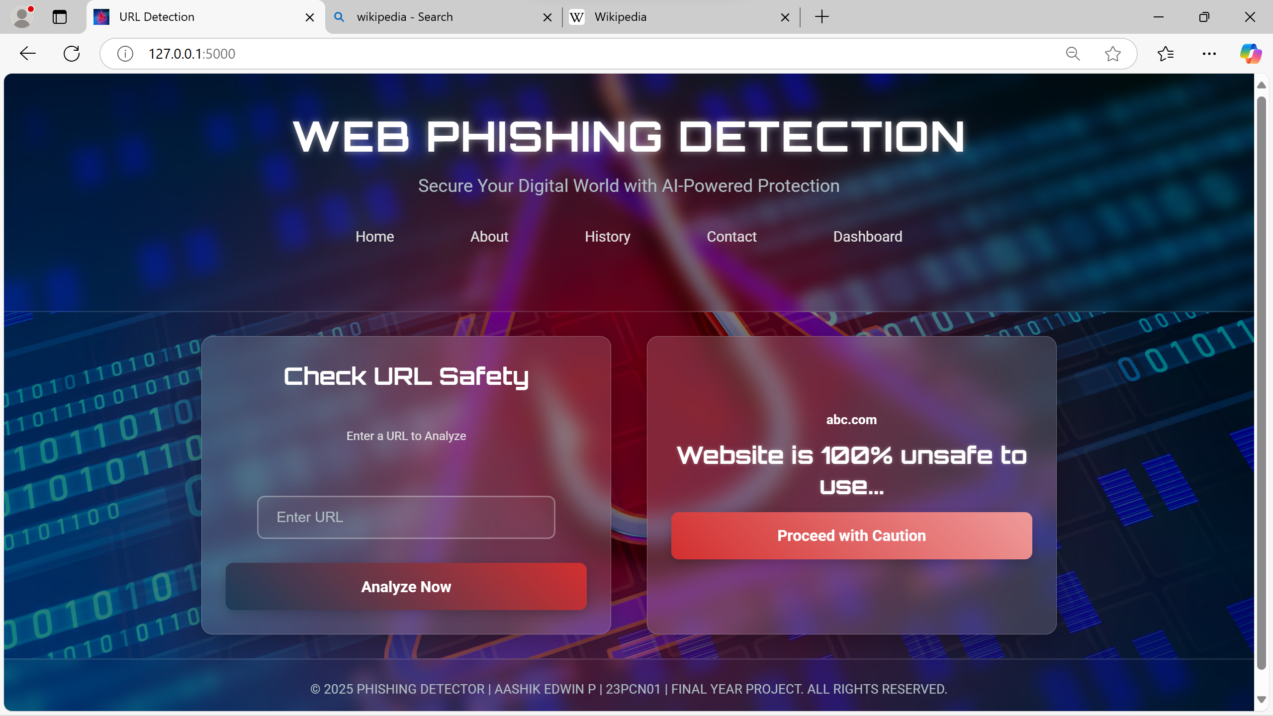
Legitimate
Phishing

Slide 18
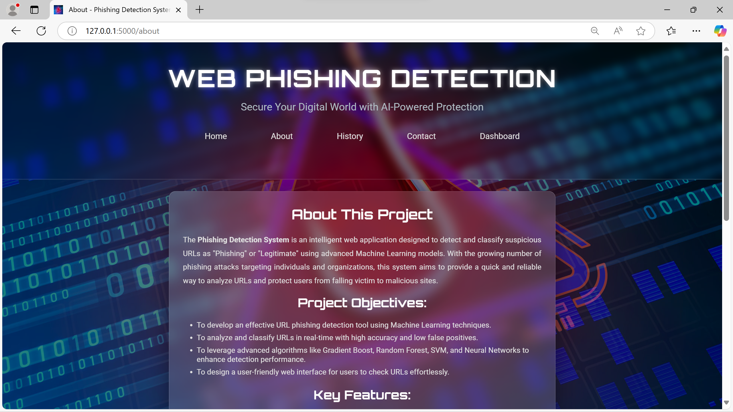
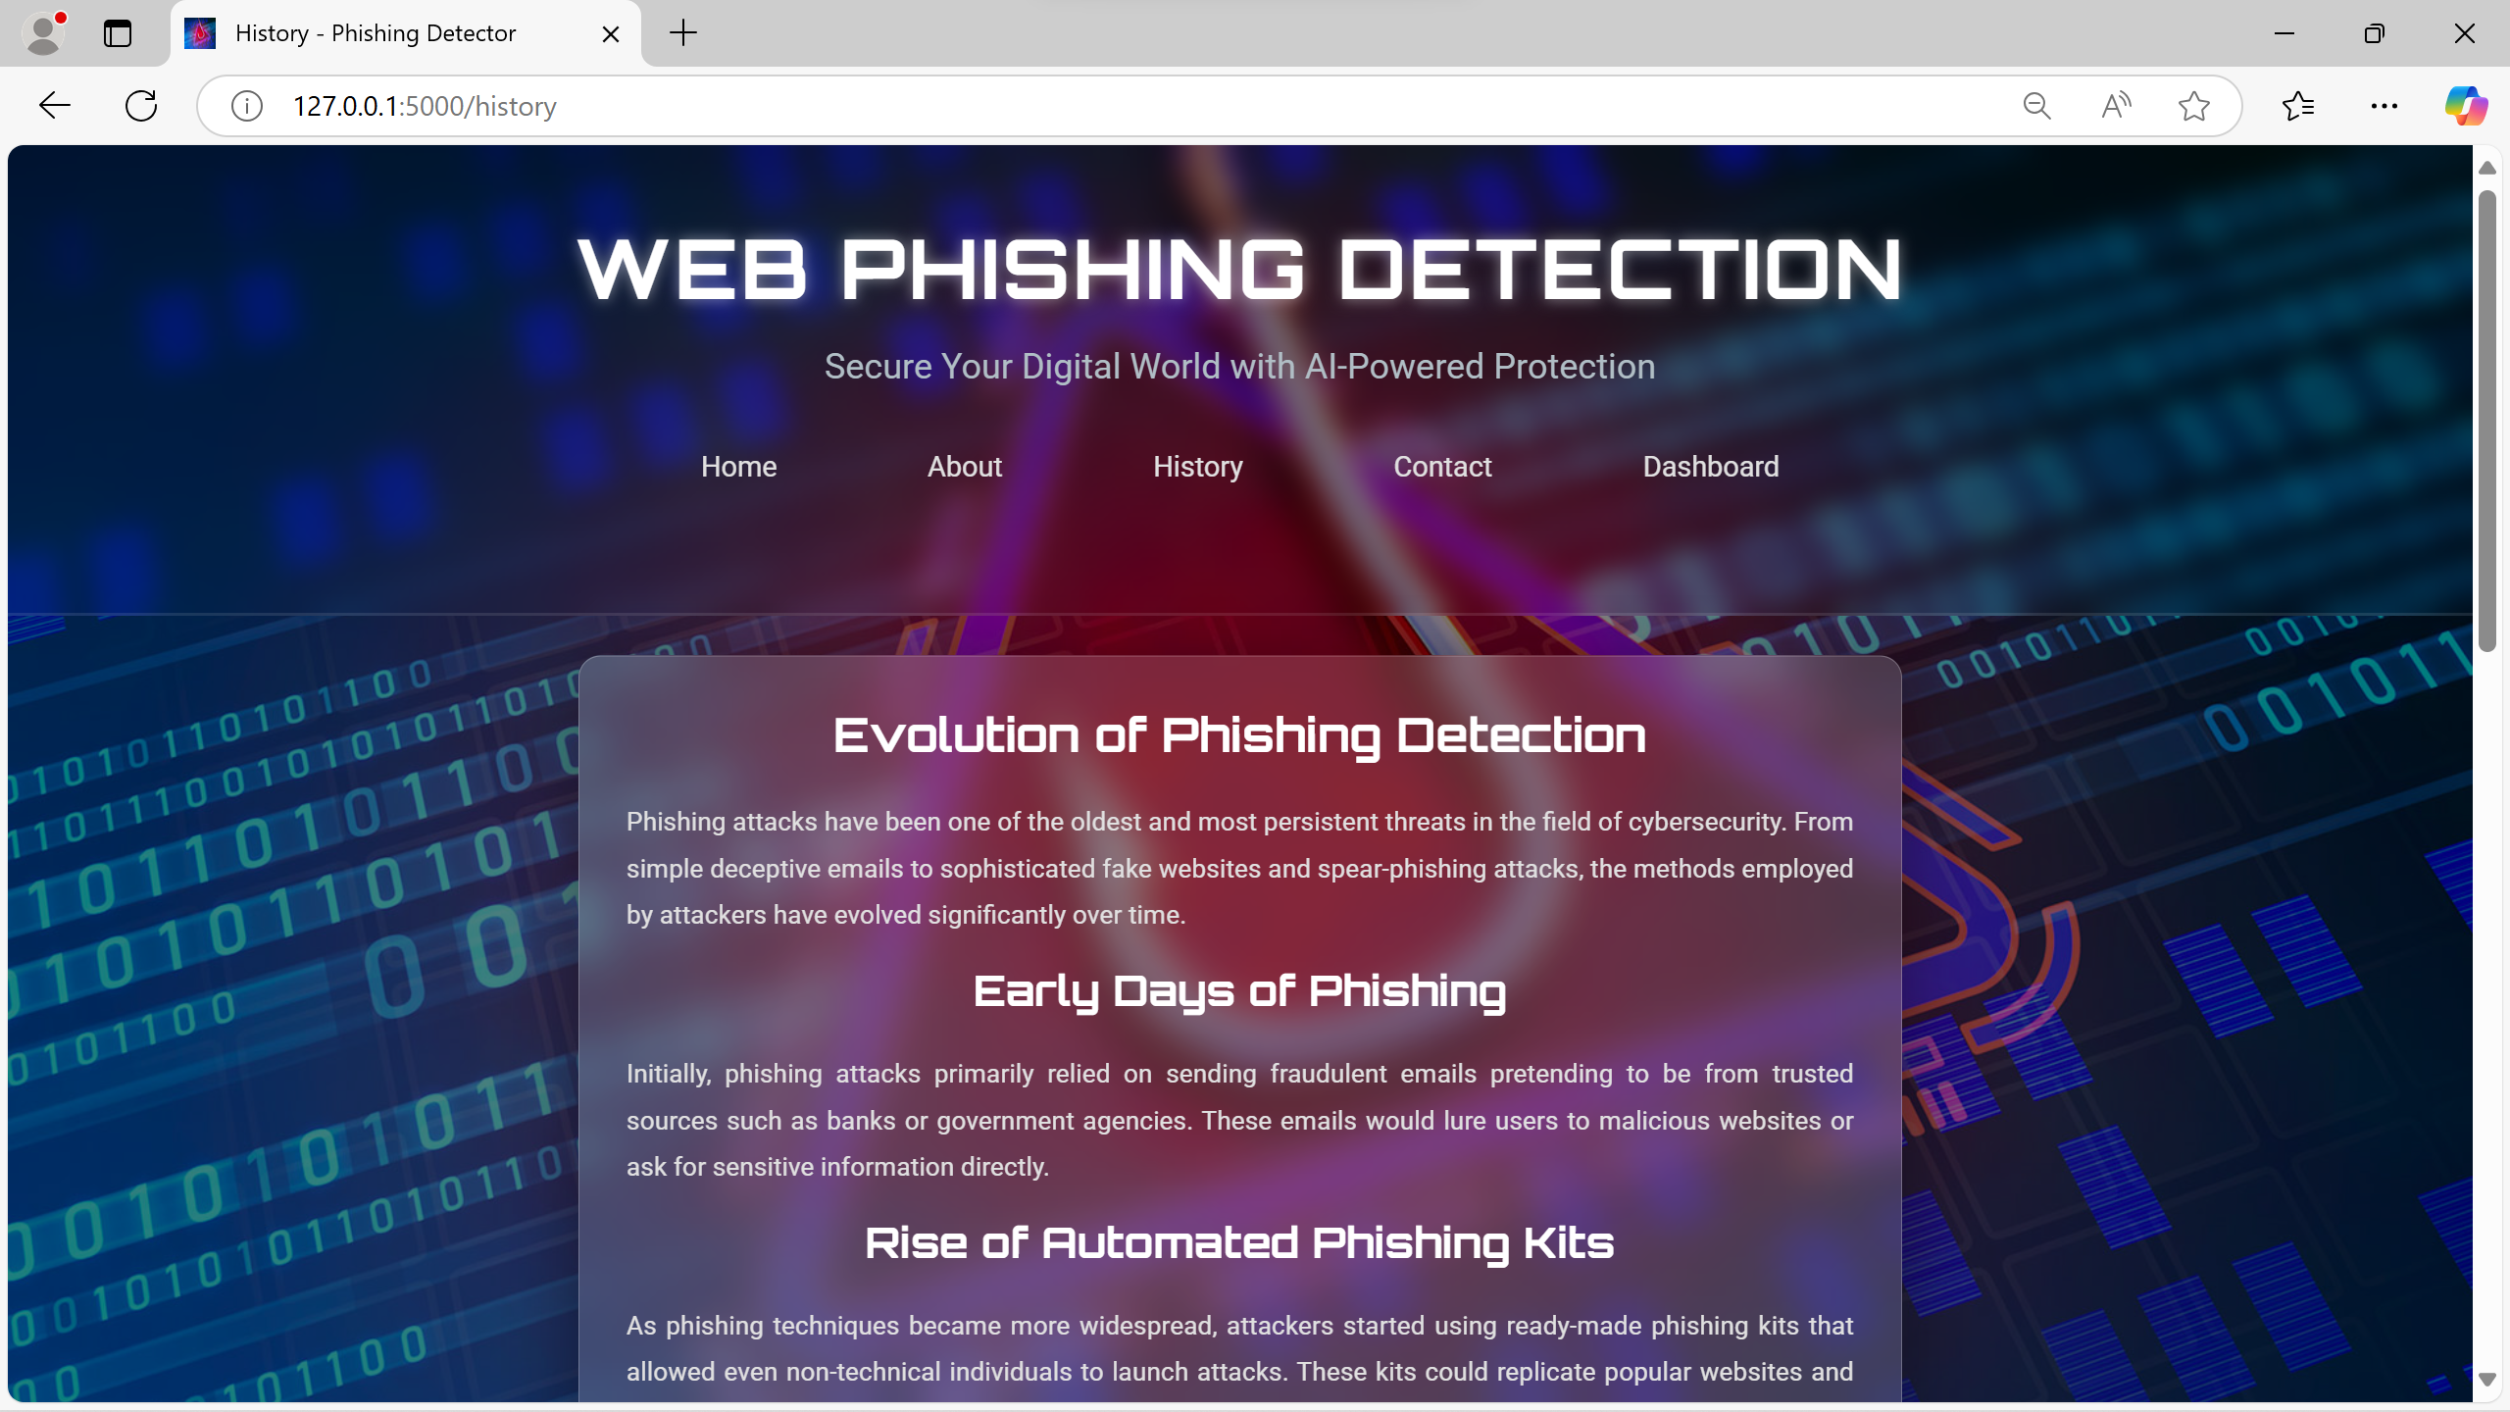
About Page
History Page

Slide 19
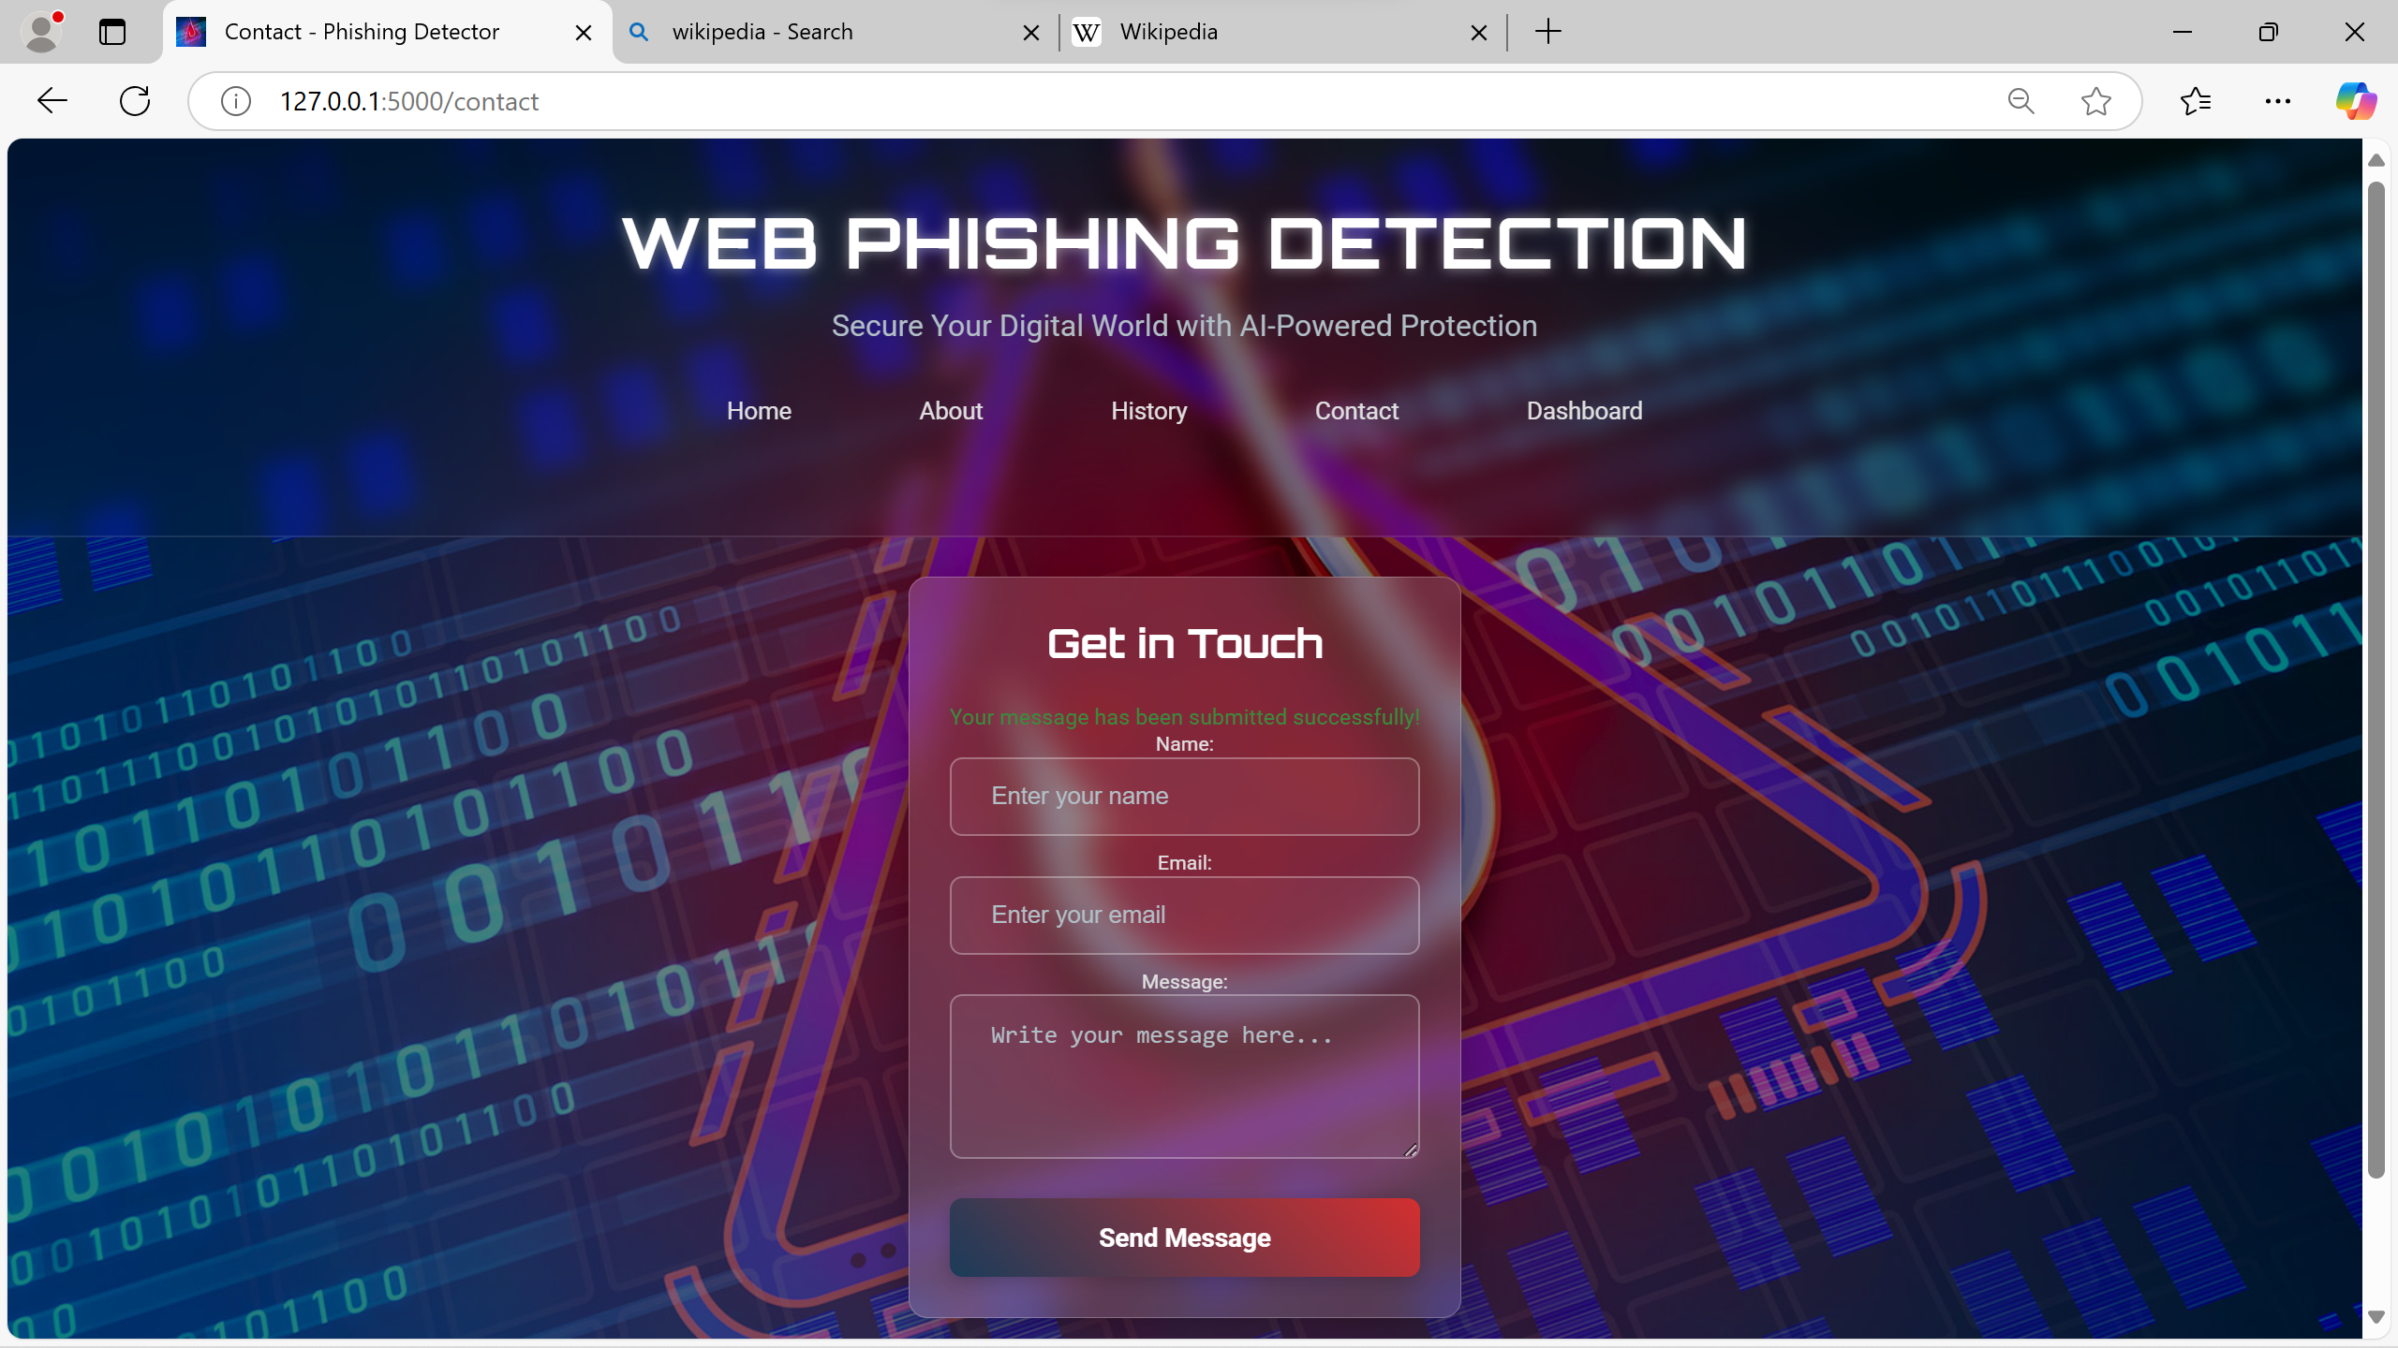
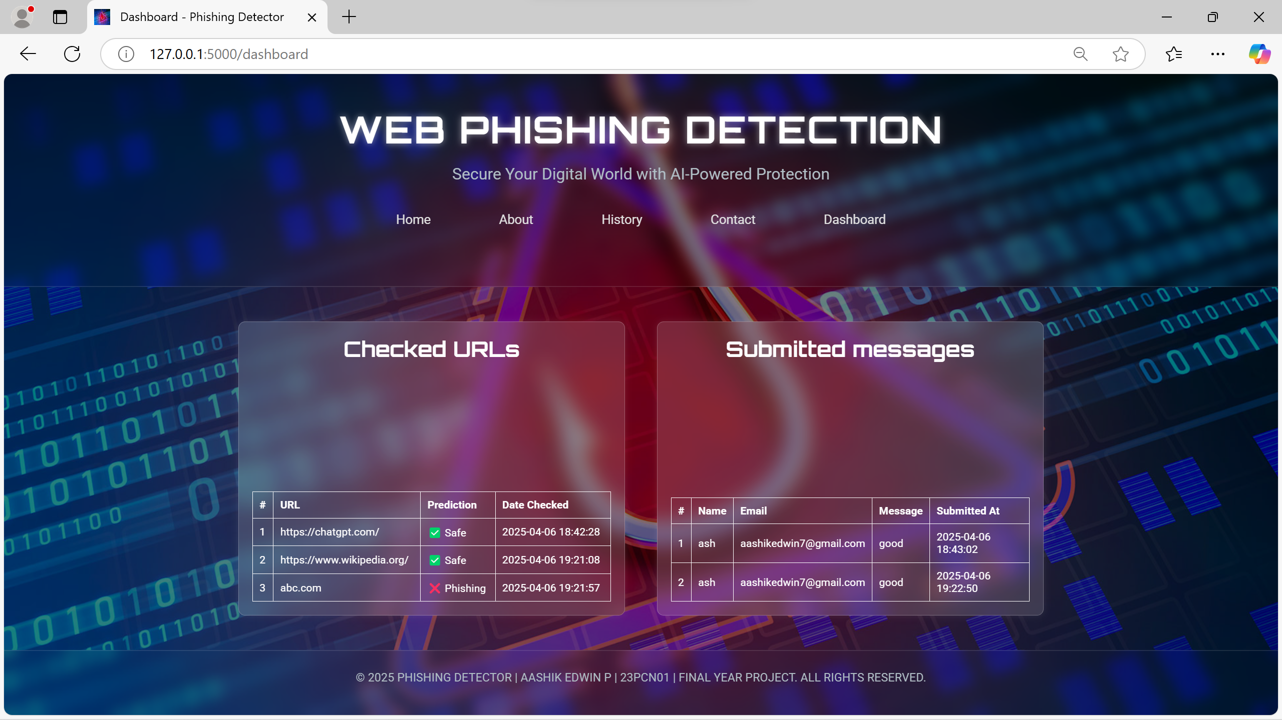
Contact Page
Dashboard Page

Slide 20
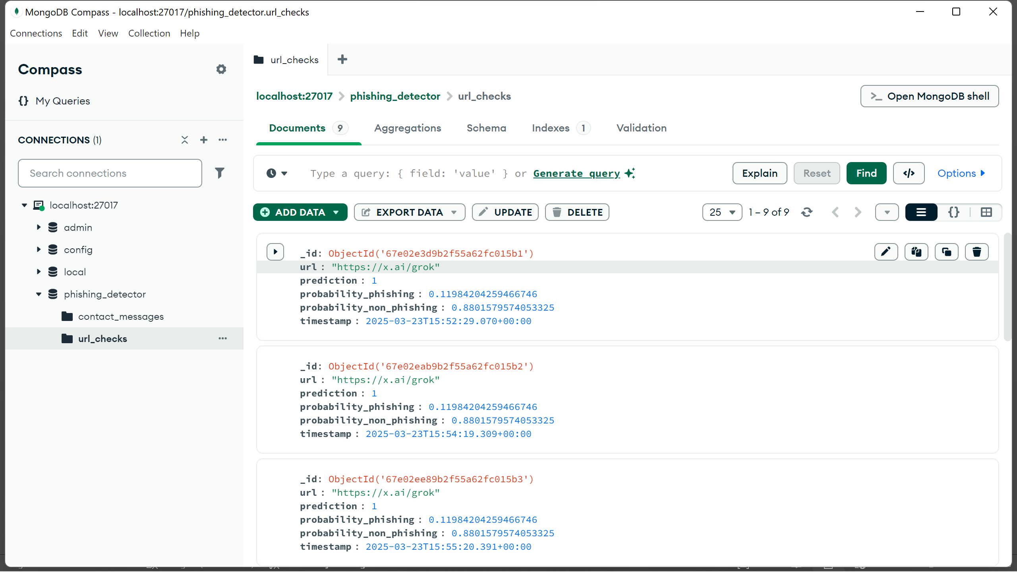
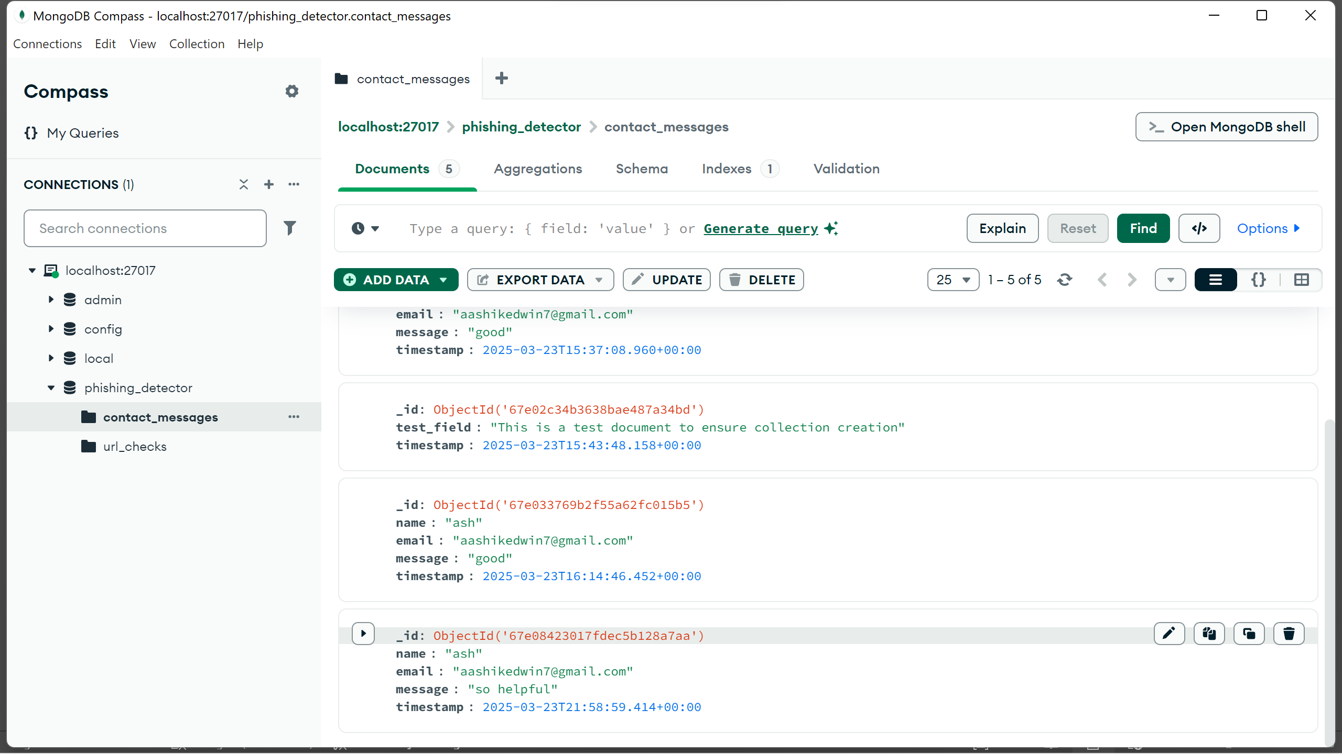
url_checks
contact_messages
MongoDB Outputs

Slide 21

CONCLUSION
Helps users and organizations understand common phishing techniques.
Detects phishing URL attacks more effectively and efficiently.
Uses machine learning models instead of traditional detection methods.

Slide 22
FUTURE ENHANCEMENTS
Use of Powerful Models Add stronger machine learning models like BERT or deep learning to make predictions more accurate.
Detect More Types of Phishing Improve the system to find not just website phishing, but also phishing through emails, messages (SMS), and phone calls.
Instant Alerts Show warning messages to users immediately when a dangerous link is found.
Browser Tool Create a browser extension that checks links while users are browsing and warns them about phishing sites.

Slide 23


